Slide 1


_{Hourglass Schemes:}
How to Prove that Cloud Files Are Encrypted
Emil Stefanov
UC Berkeley
emil@cs.berkeley.edu
Joint work with:
Marten van Dijk | Ari Juels | Alina Oprea
RSA Labs | RSA Labs | RSA Labs
marten.vandijk@rsa.com | ari.juels@rsa.com | alina.oprea@rsa.com
Ronald Rivest | Nikos Triandopoulos
MIT | RSA Labs
rivest@mit.edu | nikolaos.triandopoulos@rsa.com

Slide 2




Public Cloud Computing
Enterprise
Enterprise
Pool of shared resources
Available on demand
Highly scalable
User
User
User
Notes:
2

Slide 3



A Major Drawback
Large attack surface
  Thousands of computers
  Dozens of storage systems and interfaces
    Amazon alone: S3, EBS, Instance Storage, Glacier, Storage Gateway, CloudFront, RDS, DynamoDB, ElastiCache, CloudSearch, SQS
  Shared resources among thousands of tenants
Many possibilities for accidental data leakage.

Slide 4




Defending Against Accidental Data Leakage
???
leakage
Simple view:
  Just encrypt your data in the cloud.
  Problem solved?

Slide 5


Defending Against Accidental Data Leakage
???
leakage
More realistic view:
  Often want to use the cloud for more than just raw storage.
  Why? Want to outsource storage AND computation (services).
  In that case, the cloud needs access to your decrypted data.

Slide 6
Encrypt at Rest & Decrypt on the Fly
???
leakage
Services Front End
Storage Back End
Split the cloud into computation front-end and storage back-end
  Already the case in many clouds (e.g., Amazon, Azure)
Storage backend only sees encrypted data.
Computation front-end decrypts data on the fly
  Only accesses the data it really needs at any one time
Can be combined with tight access control and logging.
  Key servers

Slide 7
Encrypt at Rest & Decrypt on the Fly
???
leakage
☺ complies with government regulations
Services Front End
Storage Back End
Protects against data leakage by the storage back-end infrastructure.
Limits the amount of data leakage by the front-end at any one time.
Common practice.
Much better than no encryption.

Slide 8
The Problem
How can we be reasonably sure that the cloud is encrypting data at rest?
Plaintext is simpler for the cloud to manage.
Lack of visibility
  Users only see results (e.g., web pages) from the front-end. What is happening internally?
Download data and check encryption?
  The cloud can always just encrypt on the fly.
Seems impossible!

Slide 9
Our Solution
Economically motivate the cloud to encrypt data at rest.
Impose financial penalties on misbehaving cloud providers.
We ensure that an economically rational cloud provider, encrypts data at rest.
Misbehaving cloud must use double storage.
  Must store both decrypted and encrypted file.

Slide 10

Our Solution: Hourglass Schemes
encryption
hourglass
Original File
Encrypted File
Encapsulated File
client verifies encryption
client
assists
client uploads file
client verifies by periodically challenging random file blocks
The client never needs to permanently store and manage keys.

Slide 11
Intuition
encryption
hourglass
Original File
Encrypted File
Encapsulated File
Hourglass property:
costly to compute “on the fly”
client checks
adversarial cloud wants to
only store
So an adversarial cloud must store both files.
Double the storage!

Slide 12
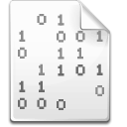
Hourglass Framework: More than a Scheme
Modular Components
Encodings:
  Encryption
  Watermarking
  File Bindings
Hourglass functions:
  Butterfly
  Permutation
  RSA

Slide 13
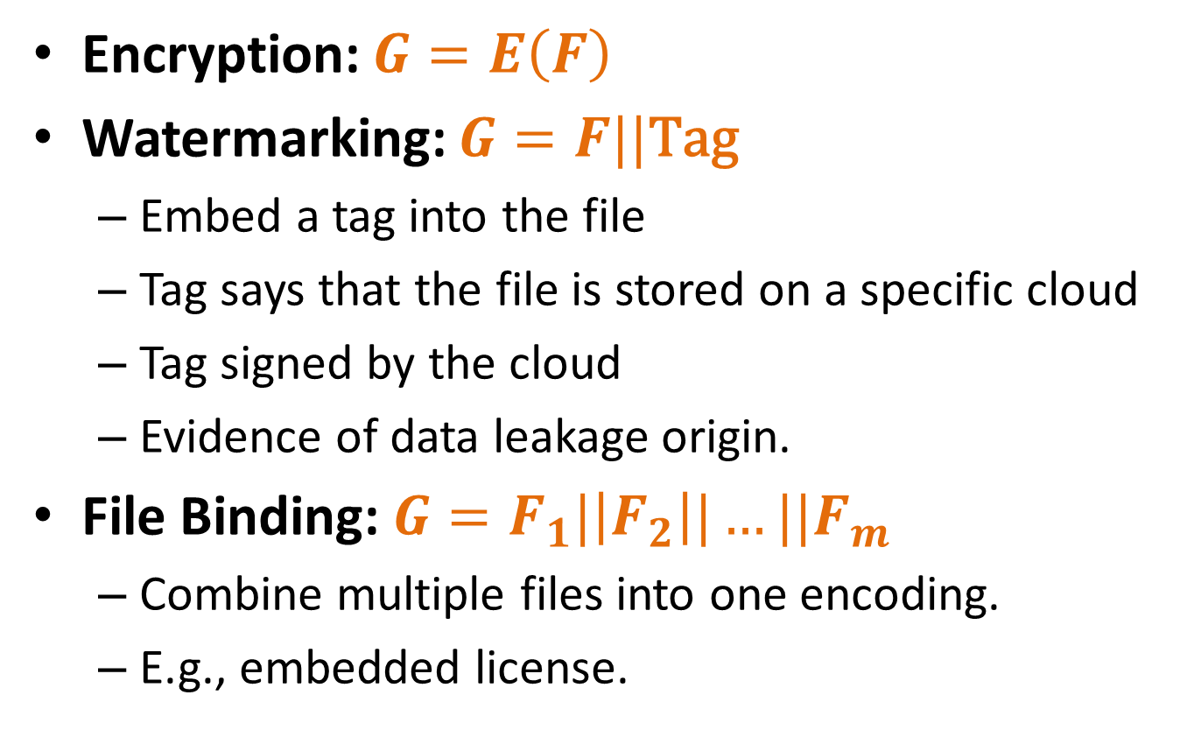
Encodings
Encryption: $G=E\left(F\right)$
Watermarking: $G=F||\text{Tag}$
  Embed a tag into the file
  Tag says that the file is stored on a specific cloud
  Tag signed by the cloud
  Evidence of data leakage origin.
File Binding: $G=F_{1}|\left|F_{2}\right||…||F_{m}$
  Combine multiple files into one encoding.
  E.g., embedded license.

Slide 14

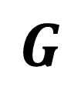
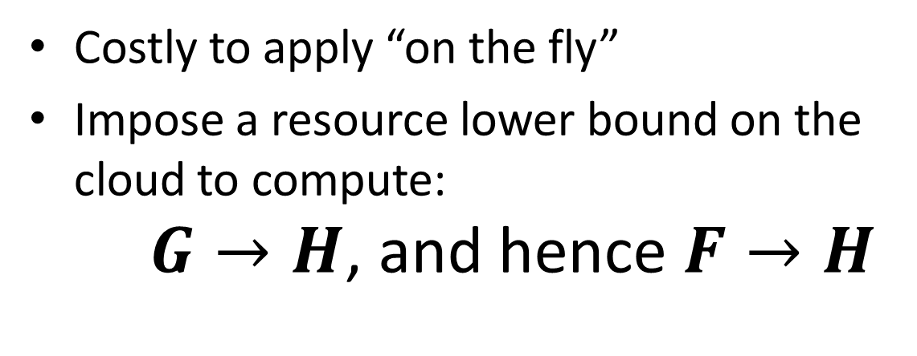
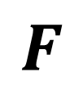
Hourglass Functions
Costly to apply “on the fly”
Impose a resource lower bound on the cloud to compute:
$G→H$, and hence $F→H$
$$F$$
$$G$$
$$H$$
encoding
(e.g., encryption)
hourglass
Original File
Encrypted File
Encapsulated File

Slide 15



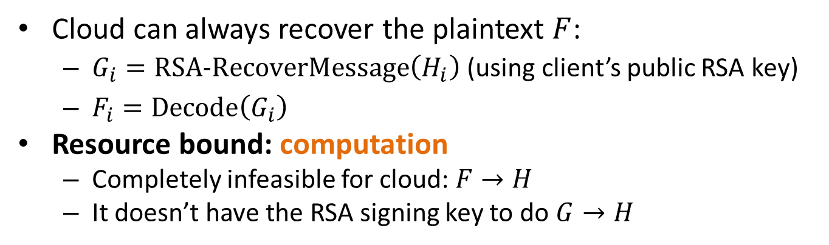
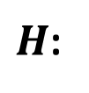














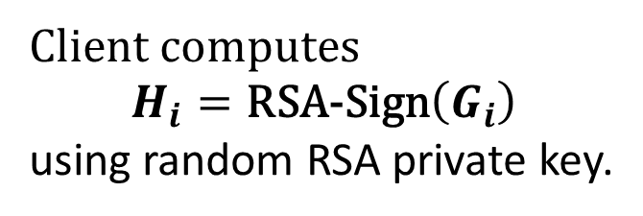
Hourglass Function: RSA
$F$:
…
$$F_{1}$$
$$F_{2}$$
$$F_{3}$$
$$F_{4}$$
$$F_{n}$$
Apply encoding (encryption, watermarking, file binding)
$G$:
…
$$G_{1}$$
$$G_{2}$$
$$G_{3}$$
$$G_{4}$$
$$G_{n}$$
Client computes
$$H_{i}=\text{RSA}\text{−}\text{Sign}\left(G_{i}\right)$$
using random RSA private key.
$H$:
$$H_{1}$$
$$H_{2}$$
$$H_{3}$$
$$H_{4}$$
…
$$H_{n}$$
Cloud can always recover the plaintext $F$:
  $G_{i}=\text{RSA}\text{−}\text{RecoverMessage}\left(H_{i}\right)$ (using client’s public RSA key)
  $F_{i}=\text{Decode}\left(G_{i}\right)$
Resource bound: computation
  Completely infeasible for cloud: $F→H$
  It doesn’t have the RSA signing key to do $G→H$

Slide 16
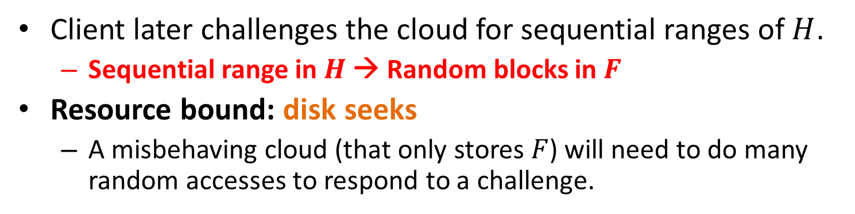
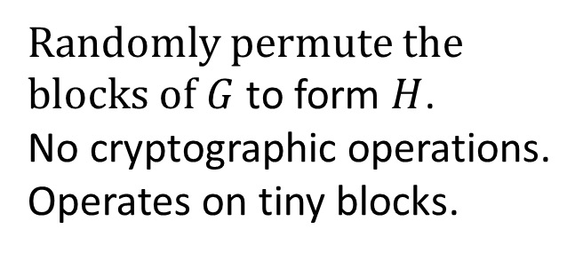
Hourglass Function: Permutation
$F$:
…
$$F_{1}$$
$$F_{2}$$
$$F_{3}$$
$$F_{4}$$
$$F_{n}$$
Apply encoding (encryption, watermarking, file binding)
$G$:
…
$$G_{1}$$
$$G_{2}$$
$$G_{3}$$
$$G_{4}$$
$$G_{n}$$
Randomly permute the blocks of $G$ to form $H$.
No cryptographic operations.
Operates on tiny blocks.
$H$:
$$H_{1}$$
$$H_{2}$$
$$H_{3}$$
$$H_{4}$$
…
$$H_{n}$$
Client later challenges the cloud for sequential ranges of $H$.
  Sequential range in $H$ → Random blocks in $F$
Resource bound: disk seeks
  A misbehaving cloud (that only stores $F$) will need to do many random accesses to respond to a challenge.

Slide 17
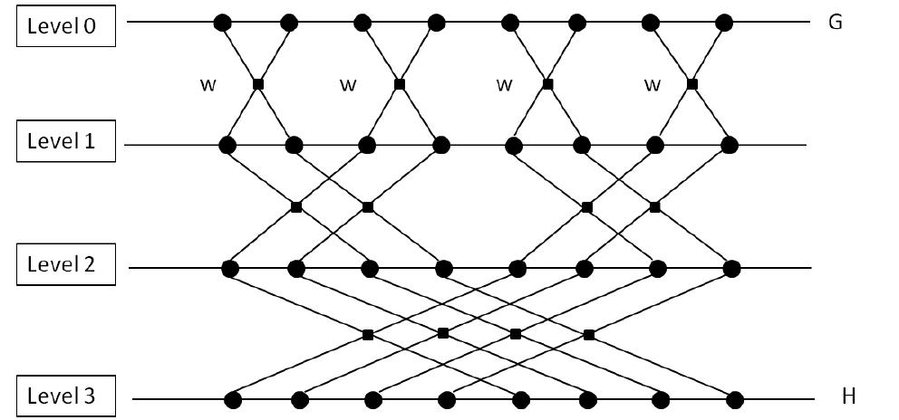
















Hourglass Function: Butterfly
w = a known key PRP over a pair of file blocks
$$G_{1}$$
$$G_{2}$$
$$G_{3}$$
$$G_{4}$$
$$G_{5}$$
$$G_{6}$$
$$G_{7}$$
$$G_{8}$$
$$H_{1}$$
$$H_{2}$$
$$H_{3}$$
$$H_{4}$$
$$H_{5}$$
$$H_{6}$$
$$H_{7}$$
$$H_{8}$$

Slide 18
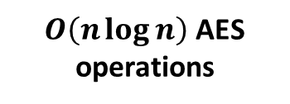
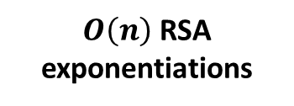
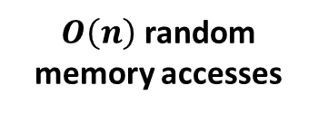
Comparison of Hourglass Functions
$O\left(n\right)$ RSA exponentiations
$O\left(n\log{n}\right)$ AES operations
$O\left(n\right)$ random memory accesses
less practical
more practical
RSA
Butterfly
Permutation
less assumptions
more assumptions
RSA assumptions
storage speed
seek inefficiency
in rotational drives

Slide 19
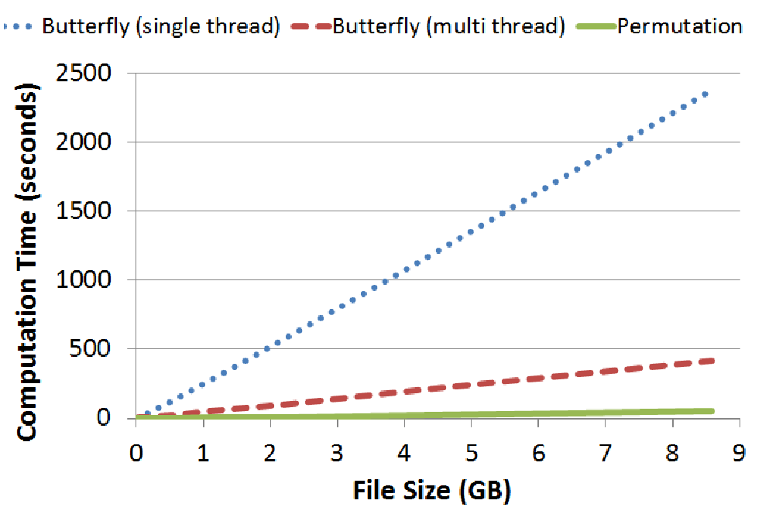
Comparison of Hourglass Functions
Ran on Amazon EC2 (using a quadruple-extra-large high-memory instance and EBS Storage).

Slide 20
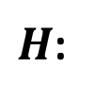
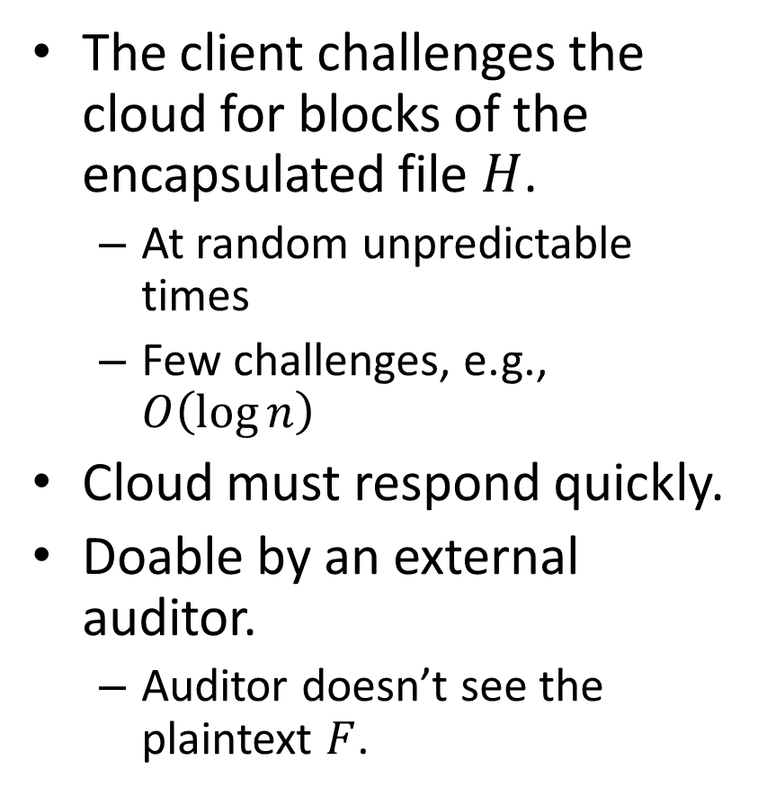




Challenge-Response Protocol
The client challenges the cloud for blocks of the encapsulated file $H$.
  At random unpredictable times
  Few challenges, e.g., $O\left(\log{n}\right)$
Cloud must respond quickly.
Doable by an external auditor.
  Auditor doesn’t see the plaintext $F$.
…
$H$:
$$H_{1}$$
$$H_{2}$$
$$H_{4}$$
$$H_{4}$$
$$H_{n}$$

Slide 21
Limitations
Assume files are not accessed to often.
  Great for archiving files.
File updates are costly.
  RSA hourglass function allows for updates.
  Other hourglass functions must be re-applied to the entire file.
Works mainly for large files.

Slide 22
Conclusions
Able to motivate the cloud to encrypt files are rest.
Several techniques
  Encryption, watermarking, file binding.
  Different hourglass functions with performance-assumption tradeoffs.
Economic models sometimes prevail where traditional cryptographic techniques cannot.

